Slide 1

Christopher Reeves VA Primary School Mathematics
Calculation Policy

Slide 2
About Calculation Policy
The following calculation policy has been devised to meet requirements of the National Curriculum 2014 for the teaching and learning of mathematics, and is also designed to give pupils a consistent and smooth progression of learning in calculations across the school.
Age stage expectations:
The calculation policy is organised according to age stage expectations as set out in the National Curriculum 2014 and the method(s) shown for each year group should be modelled to the vast majority of pupils. However, it is vital that pupils are taught according to the pathway that they are currently working at and are showing to have ‘mastered’ a pathway before moving on to the next one. Of course, pupils who are showing to be secure in a skill can be challenged to the next pathway as necessary.
Choosing a calculation method:
Before pupils opt for a written method they should first consider these steps:
Can I do it in my head using a
mental strategy?
Could I use some jottings to
help me?
Should I use a formal written method to
work it out?

Slide 3
NCETM
Calculation Guidance Principles
Develop children’s fluency with basic number facts
Develop children’s fluency in mental calculation
Develop children’s understanding of the = symbol
Teach inequality alongside teaching equality
Use empty box problems
Use intelligent practice
Expose mathematical structure and work systematically
Move between the concrete and the abstract
- Contextualise the mathematics
Notes:
https://www.ncetm.org.uk/public/files/24756940/NCETM+Calculation+Guidance+Oct+2015.pdf

Slide 4
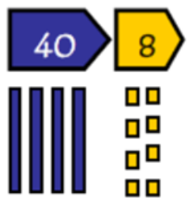
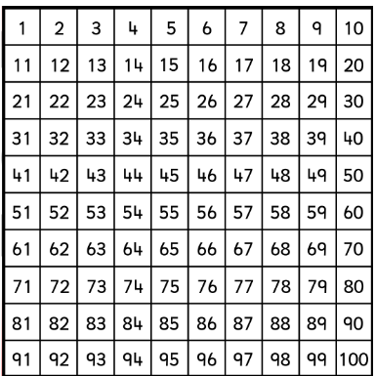
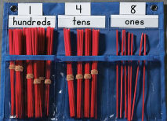
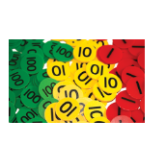
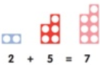
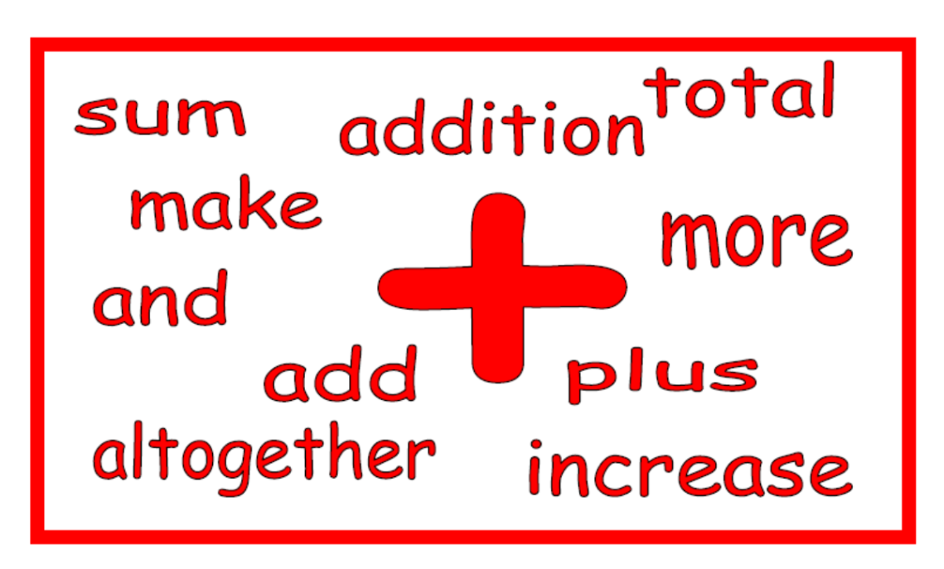
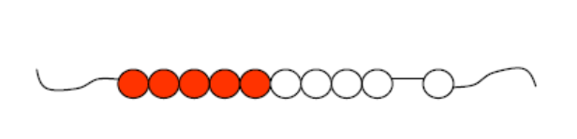
Addition
Concrete resources:
100 square
Number lines
Bead strings
Straws
Dienes
Place value cards
Place value dice
Place value counters
Numicon

Slide 5
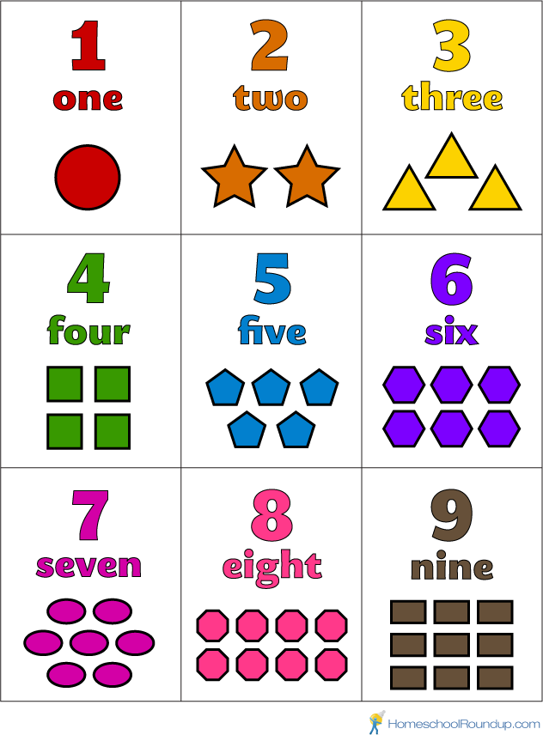
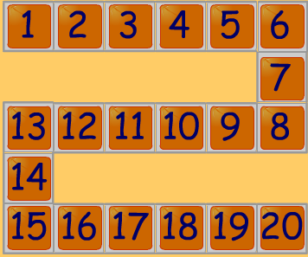
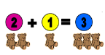
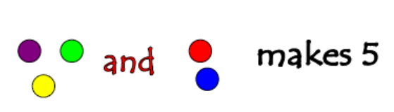
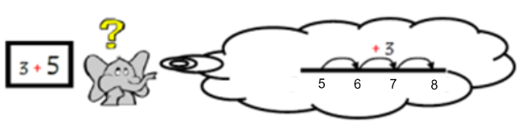
Addition: Reception
Early learning goals:
Count reliably with numbers from 1 to 20, place them in order.
Say which number is one more than a given number.
Using quantities and objects, they add two single-digit numbers and count on to find the answer.
Recognise numbers up to 20 and understand the meaning of each number by recognising and knowing their clusters
Count on in ones and say which number is one more than a given number using a number line or number track to 20.
Begin to relate addition to combining two groups of objects using practical resources, role play, stories and songs.
Know that counting on is a strategy for addition. Use numbered number lines to 20.

Slide 6
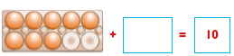
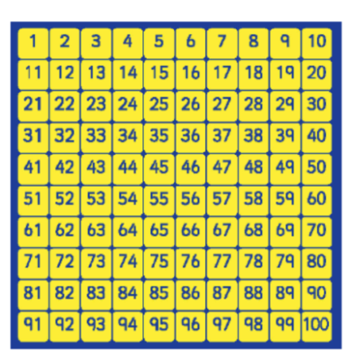
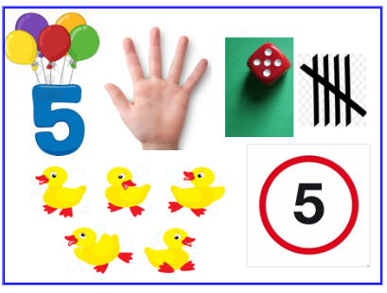
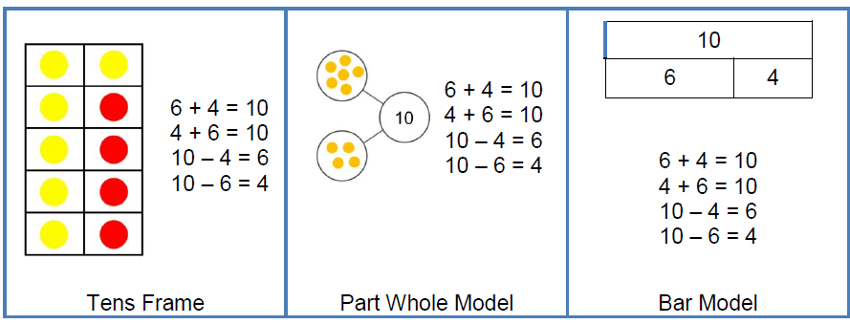
Addition: Year 1
Year 1 statutory requirements :
Count to and across 100, forwards beginning with 0 or 1, or from any given number.
Given a number, identify one more.
Read, write and interpret mathematical statements involving addition (+), and equals (=) signs.
Represent and use number bonds and related subtraction facts within 20
Add one-digit and two-digit numbers to 20, including zero.
Solve one-step problems that involve addition using concrete objects and pictorial representations, and missing number problems.
Identify and represent numbers using objects and pictorial representations (multiple representations)
Memorise and reason with number bonds to 10 and 20 in several forms.
Count on in ones to and across 100 and find one more than a given number.

Slide 7
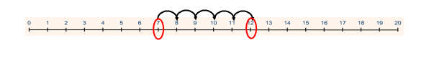
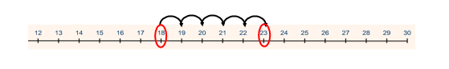
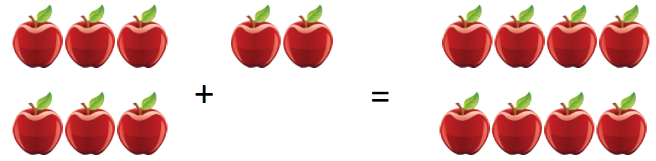
Addition: Year 1
Use concrete resources and a number line to support the addition of numbers. Know and use strategy of finding the larger number, and counting on in ones from this number.
1 digit + 1 digit
7 + 5 = 12
Begin to use the + and = signs to write calculations in a number sentence.
18 + 5 = 23
2 digit + 1 digit
Tom picks 6 apples and Raj picks 2 apples.
How many apples do they have altogether?
Solve one-step problems using concrete objects
and pictorial representations.

Slide 8
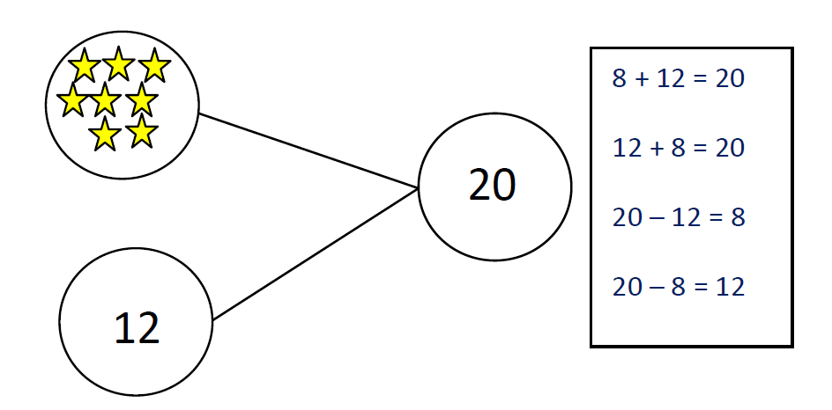
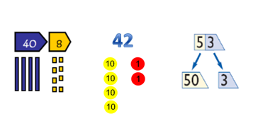

Addition: Year 2
Year 2 statutory requirements :
Recall and use addition and subtraction facts to 20 fluently, and derive and use related facts to 100.
Recognise and use the inverse relationship between addition and subtraction and use this to check calculations and solve missing number problems.
Add numbers using concrete objects, pictorial representations, and mentally, including:
  a two-digit number and ones
  a two-digit number and tens
  two two-digit numbers
  adding three one-digit numbers.
Solve problems with addition including those involving numbers, quantities and measures.
Memorise and reason with number facts to 20 in several forms.
Partition two 2-digit numbers using a variety of models and images.

Slide 9
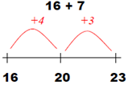
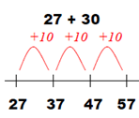
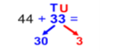
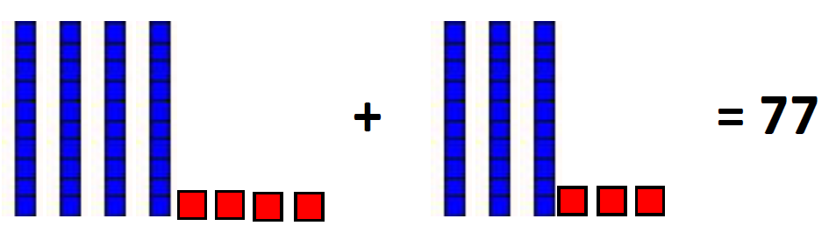
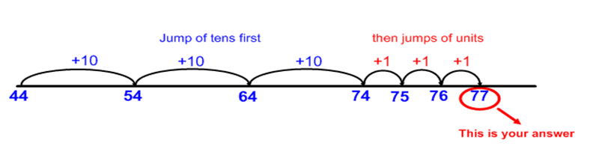
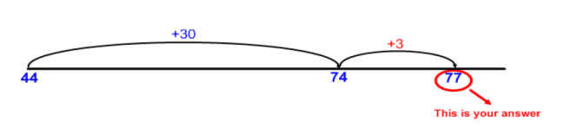
Addition: Year 2
Add 2 digit number and ones
Add 2 digit number and tens
Use partitioning to add two 2-digit numbers using concrete resources and/or a numbered number line and then progressing to an empty number line.
As children gain confidence with adding on tens and ones, they should be taught to combine the jumps on an empty number line.

Slide 10
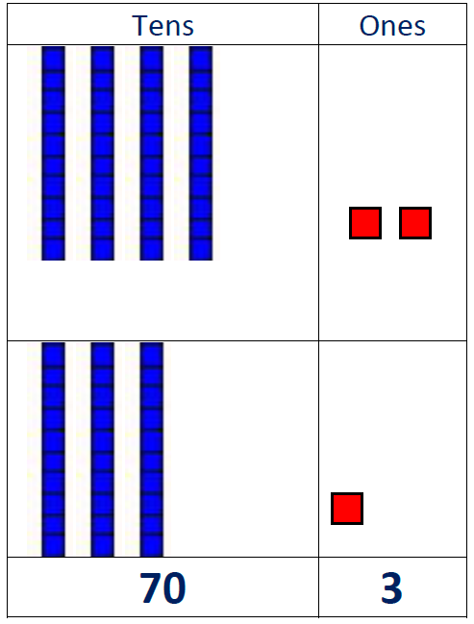
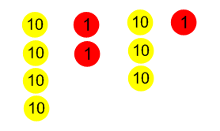
Addition: Year 3
Year 3 statutory requirements :
Find 10 or 100 more than a given number.
Recognise the place value of each digit in a three-digit number (hundreds, tens, ones).
Add numbers with up to three digits, using formal written methods of columnar addition.
Use expanded column method with place value resources to support the conceptual understanding of adding numbers up to three digits with no carrying.
42 + 31 = 73
40 + 2
30 + 1
70 + 3
OR

Slide 11
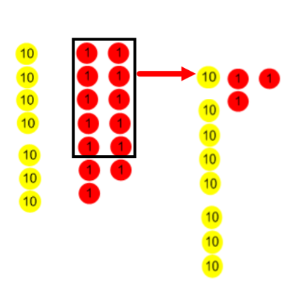
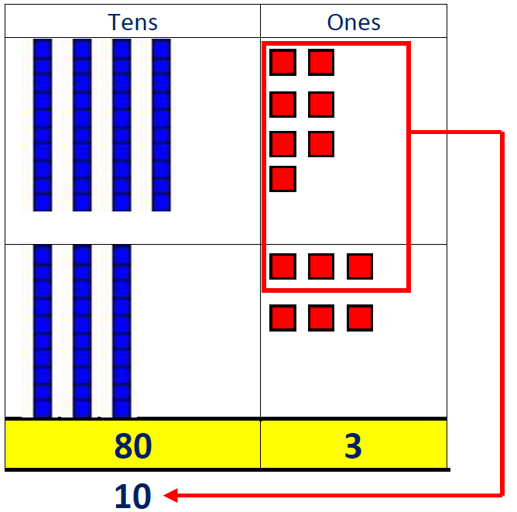
Addition: Year 3
Progress to using the expanded column method with place value resources to support the conceptual understanding of adding numbers up to three digits with carrying.
47 + 36 = 83
40 + 7
30 + 6
80 + 3
10
OR
Extend to using the expanded column method to add three digit numbers + three digit numbers with carrying.
300 + 60 + 7
100 + 80 + 5
500 + 50 + 2
100 10
367 + 185 = 552
Note: The carried ten or carried hundred is just as important as any other number, therefore, it should be written as clear and as large as any other number, and placed at the bottom of the column in which it is to be added.

Slide 12
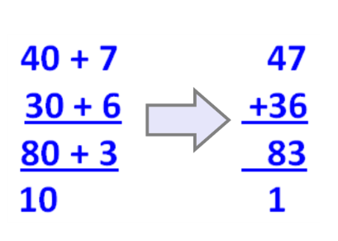
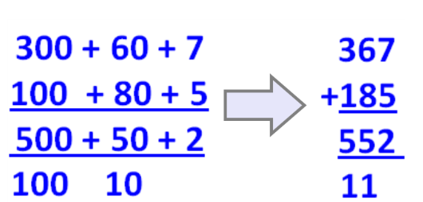
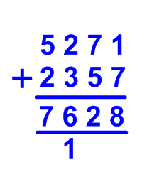
Addition: Year 4
Year 4 statutory requirements :
Find 1000 more than a given number.
Add numbers with up to 4 digits using the formal written methods of columnar addition where appropriate.
Solve addition two-step problems in contexts, deciding which operations and methods to use and why,
Note: The carried ten or carried hundred is just as important as any other number, therefore, it should be written as clear and as large as any other number, and placed at the bottom of the column in which it is to be added.
Build on learning from Year 3 and model how expanded method links to compact column addition method.
By the end of year 4, pupils should be adding numbers up to 4 digits using compact column addition method.

Slide 13
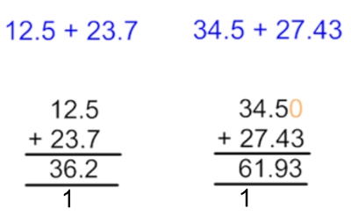
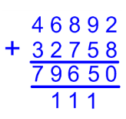
Addition: Year 5 & 6
Year 5 statutory requirements :
Add whole numbers with more than 4 digits using formal written methods of columnar addition.
Add numbers mentally, with increasingly large numbers.
Solve addition multi-step problems in contexts, deciding which operations and methods to use and why.
Solve problems involving numbers up to three decimal places
Year 6 statutory requirements :
Pupils are expected to solve more complex addition and subtraction problems
In year 5 and 6 pupils should be adding numbers using compact column addition method. Note: The carried ten, hundred, thousand is just as important as any other number, therefore, it should be written as clear and as large as any other number, and placed at the bottom of the column in which it is to be added.
When adding decimals, it is essential that the decimal point does not move and kept in line.
Where necessary, a zero should be added as a place holder.

Slide 14
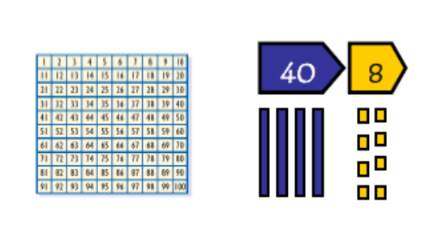
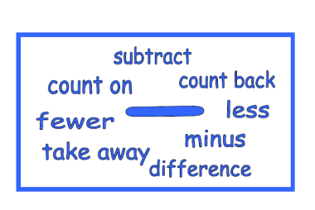
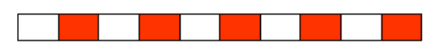
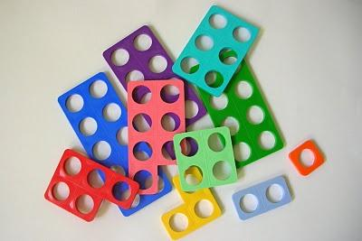
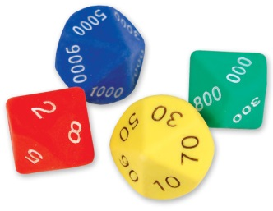
Subtraction
Concrete resources:
100 square
Number lines
Bead strings
Straws
Dienes
Counting stick
Place value dice
Place value cards
Place value counters

Slide 15
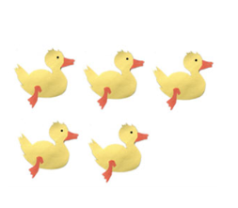
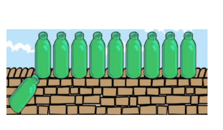
Subtraction: Reception
Early learning goals:
Say which number is one less than a given number.
Using quantities and objects, they subtract two single-digit numbers and count back to find the answer.
Say which number is one less than a given number using a number line or number track to 20.
Begin to count backwards in familiar contexts such as number rhymes or stories.
5 little ducks went swimming one day...
10 Green Bottles sitting on the wall ...
Begin to relate subtraction to ‘taking away’ using concrete objects and role play.
If I take away four shells there are six left
Three teddies take away two teddies leaves one teddy
Count backwards along a number line to ‘take away’

Slide 16
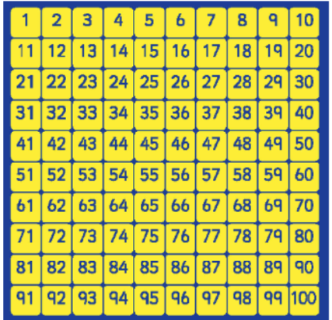

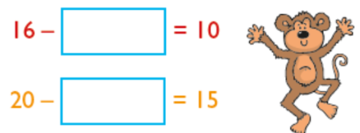
Subtraction: Year 1
Year 1 statutory requirements:
Say which number is one less than a given number.
Represent and use number bonds and related subtraction facts within 20.
Read, write and interpret mathematical statements involving subtraction (-) and equals (=) signs.
Subtract one-digit and two-digit numbers to 20, including zero.
Solve one-step problems that involve subtraction using concrete objects and pictorial representations, and missing number problems.
Understand subtraction as take away. Use practical resources, pictorial representations, role play, stories and rhymes.
Use number bonds and related subtraction facts within 20.
Count back in ones and find one less than a given number.

Slide 17
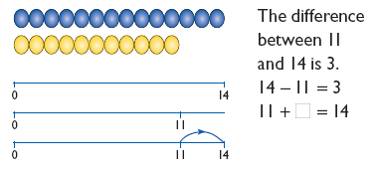
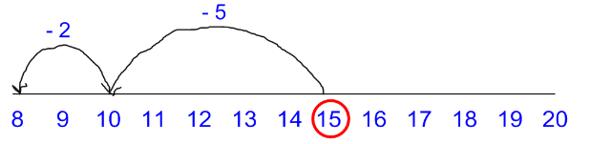
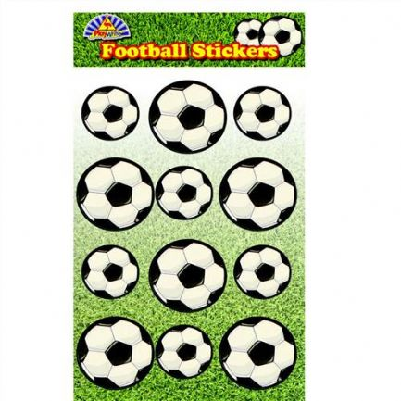
Subtraction: Year 1
Counting on should only be used when the language used is ‘find the difference’, ‘difference between’ and ‘distance between’.
Use number line to support the subtraction of numbers. Know and use strategy of counting back to subtract one-digit and two-digit numbers to 20.
15 – 7 = 8
Solve one-step problems using concrete objects
and pictorial representations.
Begin to use the - and = signs to write calculations in a number sentence.
Dan has 12 football stickers.
He gives 4 to Ben.
How many stickers does he have left?
12
- 4 =
8

Slide 18
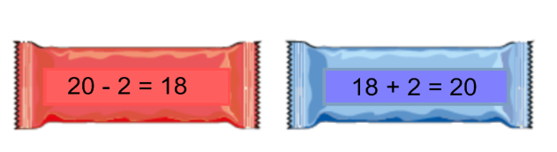
Subtraction: Year 2
Year 2 statutory requirements:
Recall and use subtraction facts to 20 fluently, and derive and use related facts to 100.
Recognise and use the inverse relationship between addition and subtraction and use this to check calculations and solve missing number problems.
Subtract numbers using concrete objects, pictorial representations, and mentally, including:
  a two-digit number and ones
  a two-digit number and tens
  two two-digit numbers
  adding three one-digit numbers.
Memorise and reason with number facts to 20 in several forms.
Partition two 2-digit numbers using a variety of models and images.

Slide 19
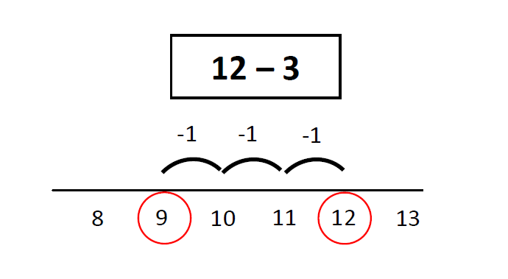




Subtraction: Year 2
Subtract 2 digit and ones
Subtract 2 digit and tens
Use partitioning to subtract two 2-digit numbers using concrete resources and/or a numbered number line and then progressing to an empty number line.
OR

Slide 20

Subtraction: Year 3
Year 3 statutory requirement:
Find 10 or 100 less than a given number.
Recognise the place value of each digit in a three-digit number (hundreds, tens, ones).
Subtract numbers with up to three digits, using formal written methods of column subtraction.
Subtract numbers mentally, including:
  A three-digit number and ones
  A three-digit number and tens
  A three-digit number and hundreds.
Use expanded column method with place value resources to support the conceptual understanding of subtracting numbers with up to three digits with no exchanging.
42 - 11 = 31
40 + 2
10 + 1
30 + 1
=
OR
-

Slide 21




Subtraction: Year 3
Progress to using the expanded column method with place value resources to support the conceptual understanding of subtracting numbers with up to three digits with exchanging tens and/or hundreds.
74 - 27 = 47
In this example to subtract 7 ones from 4 ones we need to exchange a ten for ten ones. We now can subtract 7 ones from 14 ones.
OR
Extend to using the expanded column method to subtract three digit numbers from three digit numbers.
Note: The exchanged ten or hundred is just as important as any other number, therefore, it should be written as clear and as large as any other number, and placed at the top of the column which has been adjusted.
537 – 254 = 283

Slide 22




Subtraction: Year 4
Year 4 statutory requirements:
Find 1000 less than a given number.
Subtract numbers with up to four digits, using formal written methods of columnar subtraction where appropriate.
Solve subtraction two-step problems in contexts, deciding which operations and methods to use and why.
Build on learning from Year 3 and model how expanded method links to compact column subtraction method.
Note: The exchanged ten or hundred is just as important as any other number, therefore, it should be written as clear and as large as any other number, and placed at the top of the column which has been adjusted.
By the end of year 4, pupils should be subtracting numbers up to 4 digits using compact column subtraction method.

Slide 23



Subtraction: Year 5 & 6
Year 5 statutory requirements :
Subtract whole numbers with more than 4 digits using formal written methods of columnar subtraction.
Subtract numbers mentally, with increasingly large numbers.
Solve addition and subtraction multi-step problems in contexts, deciding which operations and methods to use and why.
Solve problems involving numbers up to three decimal places.
Year 6 statutory requirements: pupils are expected to solve more complex addition and subtraction problems
In year 5 and 6 pupils should be subtracting numbers using compact column subtraction method. Note: The exchanged ten or hundred is just as important as any other number. Therefore, it should be written as clear and as large as any other number, and placed at the top of the column which has been adjusted.
When subtracting decimals, it is essential that the decimal point does not move and kept in line.
Where necessary, a zero should be added as a place holder.
0

Slide 24



Multiplication
Concrete resources
Place value counters
Dienes
Place value charts
Arrays
Multiplication squares
100 square
Number lines
Blank number lines
Counting stick

Slide 25










Multiplication: Reception
Early learning goal statutory requirement:
They solve problems, including doubling, halving and sharing.
Use pictorial representations and concrete resources to double numbers to 10.
Use concrete sources, role play, stories and songs to begin counting in twos, fives and tens.

Slide 26



Multiplication: Year 1
Year 1statutory requirement:
Solve one-step problems involving multiplication by calculating the
answer using concrete objects, pictorial representations and arrays with the support
of the teacher.
Count in twos, fives and tens using practical resources, role play, stories and songs.
Use arrays
Understand multiplication as repeated addition – use concrete objects to support understanding.
Use pictorial representations
2 2 2 2
+
+
+

Slide 27



Multiplication: Year 2
Year 2 statutory requirement:
Recall and use multiplication and division facts for the 2, 5 and 10 multiplication
tables, including recognising odd and even numbers.
Calculate mathematical statements for multiplication and division within the multiplication tables and write them using the multiplication (×), division (÷) and equals (=) signs.
Show that multiplication of two numbers can be done in any order (commutative) and division of one number by another cannot.
Solve problems involving multiplication and division, using materials, arrays, repeated addition, mental methods, and multiplication and division facts, including problems in contexts.
Further develop understanding multiplication as repeated addition.
Use pictorial representations
Use arrays
Recall multiplication and division facts for
2, 5, 10
Model and bridge link from repeated addition to solving multiplication problems using a number line.

Slide 28






Multiplication: Year 3
Year 3 statutory requirements:
Recall and use multiplication and division facts for the 3, 4 and 8 multiplication tables.
Write and calculate mathematical statements for multiplication using the multiplication tables that they know, including for two-digit numbers times one-digit numbers, using mental and progressing to formal written methods.
Solve problems, including missing number problems, involving multiplication including positive integer scaling problems and correspondence problems in which n objects are connected to m objects.
Develop recall of multiplication facts (alongside inverse of the corresponding division facts).
Use concrete resources to develop conceptual understanding of the compact method introduced in Year 4.
5cm
12 x 4 = 48
?cm
The yellow ribbon is 4 times as long
as the red ribbon. What is it’s length?
OR

Slide 29




Multiplication: Year 4
Year 4 statutory requirement:
Recall multiplication and division facts for multiplication tables up to 12 × 12
Use place value, known and derived facts to multiply and divide mentally, including: multiply two-digit and three-digit numbers by a one-digit number using formal written layout.
Solve problems involving multiplying and adding, including using the distributive law to multiply two digit numbers by one digit, integer scaling problems and harder correspondence problems such as n objects are connected to m objects.
Build on learning from Year 3 and model how grid method and/or expanded method links to compact short multiplication.
Develop recall of multiplication facts (alongside the inverse of the corresponding division facts).
Use knowledge of times tables to solve scaling problems.
Cupcakes | Flour
4 | 150g
12 | 900g
Susie wants to bake 12 cupcakes people.
The ingredients given are for four cupcakes.
How much flour will she need?
2 eggs
150g flour
180g sugar
x3
x3

Slide 30





Multiplication: Year 5
Year 5 statutory requirements:
Multiply numbers up to 4 digits by a one- or two-digit number using a formal written method, including long multiplication for two-digit numbers.
Multiply and divide whole numbers and those involving decimals by 10, 100 and 1000
To multiply by 10, 100, 1000 children should use place value charts to show that the digit moves a column (s) to the left .The value of the digit is increasing by 10, 100 or 1000 times.
Build on learning from Year 4 and use concrete resources if needed to multiply numbers up to 4 digits by
one digit using compact short multiplication.
X 10
Reinforce the connection between the grid method to multiply numbers up to 4 digits by two digit using long multiplication.

Slide 31

Multiplication: Year 6
Year 6 statutory requirements:
Multiply multi-digit numbers up to 4 digits by a two-digit whole number using the
formal written method of long multiplication.
Multiply one-digit numbers with up to two decimal places by whole numbers.
Build on learning from Year 5 multiplying numbers
using compact short multiplication and long division.
Use compact short multiplication to multiply decimal number by whole number.

Slide 32



Division
Concrete resources:
Arrays
Multiplication squares
100 square
Number lines
Blank number lines
Counting stick
Place value apparatus

Slide 33



Division: Reception
Early learning goal statutory requirement:
They solve problems, including halving and sharing.
Use pictorial representations and concrete resources to halve numbers to 10.
Begin to share quantities using practical resources, role play, stories and songs.
Role play example:
It is the end of the party and the final two teddies are waiting for their party bags. Provide empty party bags and a small collection of items such as gifts, balloons and slices of cake. Ask the children to share the objects between the two bags.

Slide 34



Division: Year 1
Year 1 statutory requirement:
solve one-step problems involving multiplication and division, by calculating the answer using concrete objects, pictorial representations and arrays with the support of the teacher.
Understand division as sharing
using concrete resources.
Pictorial representation of sharing 12 gold coins between 2, 3 and 4 pirates!
Begin to understand division as grouping using concrete resources.

Slide 35



Division: Year 2
Year 2 statutory requirement:
Recall and use division facts for 2, 5 and 10 multiplication tables.
Calculate mathematical statements for multiplication and division within the multiplication tables and write then using the multiplication (x), division ( ) and equals (=) signs.
Solve problems involving multiplication and division, using materials, arrays, repeated addition, mental methods, and multiplication and division facts, including problems in contexts.
Find 1/3; 1/4; 2/4; ¾ of a length, shape, set of objects or quantity
Further develop understanding of difference between sharing and grouping using concrete resources.
Model division as grouping on a number line (ITP ‘Grouping’)
Reinforce division
through the use of arrays.
18 ÷3 = 6
18 ÷6 = 3
18 smiley faces shared between 3 classes.
Children use numbered number lines to divide using grouping.
Remember to develop connections between fractions and division and rephrase this calculation as 1/3 of 18 is the same as 18 ÷ 3 = 6.

Slide 36




Division: Year 3 & 4
Year 3 statutory requirement:
Recall and use multiplication and division facts for the 3, 4 and 8 multiplication tables
Write and calculate mathematical statements for division using the multiplication tables that they know, including for two-digit numbers times one-digit numbers, using mental and progressing to formal written methods
Solve problems, including missing number problems, involving division including positive integer scaling problems and correspondence problems in which n objects are connected to m objects.
Year 4 statutory requirement: Note - there isn’t a statutory objective for division. However, Y4 statutory multiplication objectives are to (1) recall multiplication and division facts for multiplication tables up to 12 × 12 and (2) multiply two-digit and three-digit numbers by a one-digit number using formal written layout so we will build on the connections between multiplication and division.
See video link in ‘notes’ to consider how to develop conceptual understanding of division using dienes.
Limit numbers to NO remainders in the answer OR carried (each digit must be a multiple of the divisor).
Limit numbers to NO remainders in the final answer, but with remainders occurring within the calculation.
Extend to 3-digit number first where the divisor can go into the first number and then progress to when the divisor cannot go into the first number.
Remember to develop connections between fractions and division and rephrase these calculations as 1/3 of 96; ¼ of 72, ¼ of 872 and 1/5 of 185. Note: Year 3 fraction objective - Recognise, find and write fractions of a discrete set of objects: unit fractions and non-unit fractions with small denominators; Year 4 fraction objective: solve problems involving increasingly harder fractions to calculate quantities, and fractions to divide quantities, including non-unit fractions where the answer is a whole number.
Notes:
https://www.youtube.com/watch?v=8IXAqXGDMXw

Slide 37


Division: Year 5
Year 5 statutory requirement:
divide numbers up to 4 digits by a one-digit number using the formal written method of short division and interpret remainders appropriately for the context.
218 ÷ 8 =
Further secure pupils’ understanding of compact short division.

Slide 38


Division: Year 6
Year 6 statutory requirement:
divide numbers up to 4 digits by a two-digit whole number using the formal written method of long division, and interpret remainders as whole number remainders, fractions, or by rounding, as appropriate for the context
218 ÷ 8 =
Continue to use compact short division to divide numbers up to 4 digits by a 1-digit whole number.
Use long division to divide numbers up to 4 digits by a 2-digit whole number.

