Slide 1
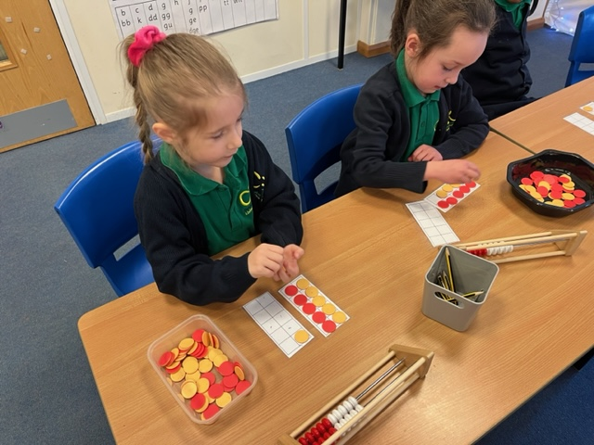
Maths at Christopher Reeves Primary

Slide 2
Welcome to our maths morning
Aims:
To give you an understanding of how we teach maths at Christopher Reeves Primary School.
To understand some of the calculation strategies that we use so that you can support your child’s learning.
To hopefully see that maths is fun.

Slide 3
Our Curriculum
At Christopher Reeves the skills required by the National Curriculum are embedded within maths lessons and developed consistently over time.
We aim for all children to be able to:
recognise the importance of maths in the wider world
use their mathematical skills and knowledge confidently in their lives in a range of different contexts
reason mathematically
enjoy mathematics and to experience success in the subject

Slide 4
So how do we do that?
We base our planning on the White Rose Maths scheme. White Rose offers a ‘Mastery’ approach to learning.
All lessons are carefully planned so that we cater for the learners in our mixed age classes.
We use resources from other sources including the National Centre for Excellence in the Teaching of Mathematics (NCETM).

Slide 5
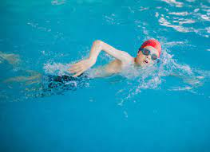
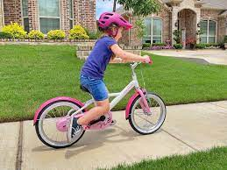
What is mastery?
What does it means to ‘master’ something?
You know how to do it.
It becomes automatic.
You get really good at it.
You could teach someone else how to do it.

Slide 6
“I’ve never been any good at maths.”
“I’m rubbish at maths.”
The essential idea behind mastery is that all children need a deep understanding of the mathematics they are learning.
This includes a belief that all pupils are capable of understanding and doing mathematics, given sufficient time. Pupils are neither ‘born with the maths gene’ nor ‘just no good at maths’. With good teaching, appropriate resources, effort and a ‘can do’ attitude all children can achieve in and enjoy mathematics.
Challenge for pupils who progress more rapidly is provided by going deeper, having rich and sophisticated problems, rather than accelerating into new concepts.

Slide 7
Numbersense and learning number facts
Numberbonds within 10
Place value
Pairs of numbers that equal ten
Counting – forwards, backwards
Multiplication tables

Slide 8
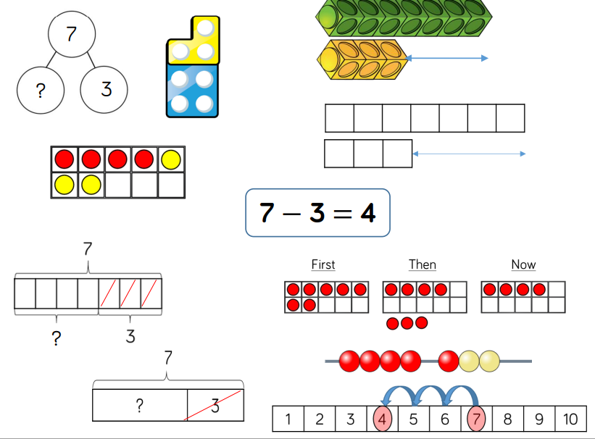
What does maths teaching look like at Christopher Reeves?
CPA approach
Concrete
Pictorial
Abstract
Concrete allows discovery
Pictorial allows conceptual understanding
Abstract allows a shorter and more efficient way to represent numerical
ideas using symbols and written digits.

Slide 9
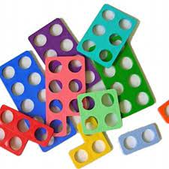
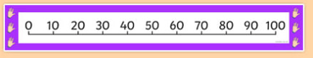
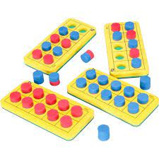
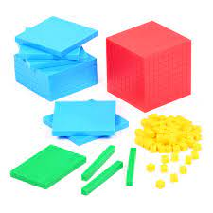

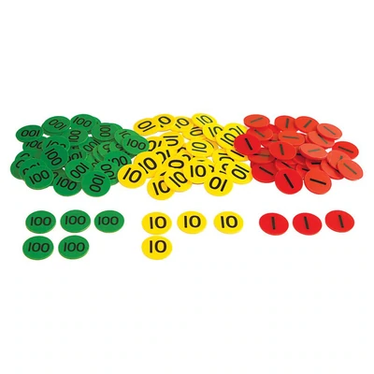
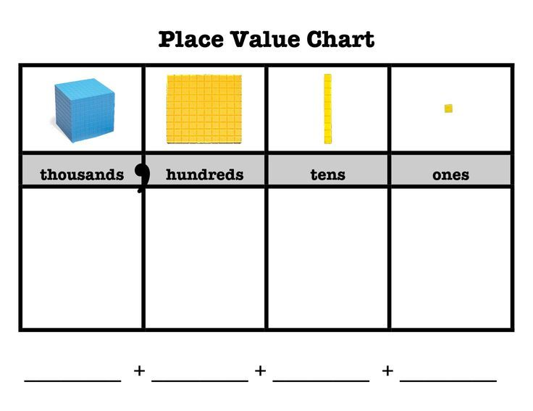
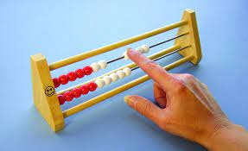
What resources do we use to support learning?
Numicon
Tens frames
numberlines
Base ten
Rekenrek
Place value counters

Slide 10
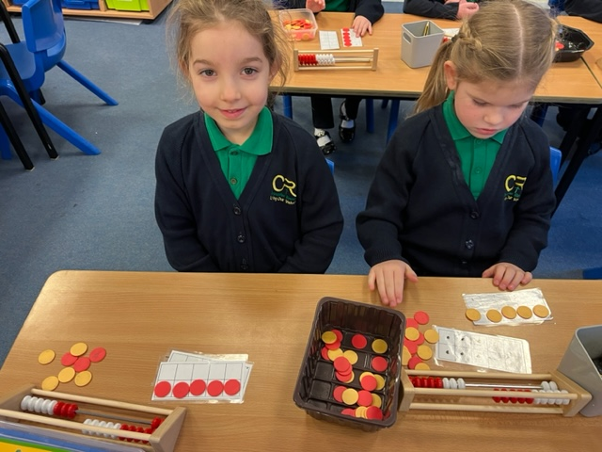
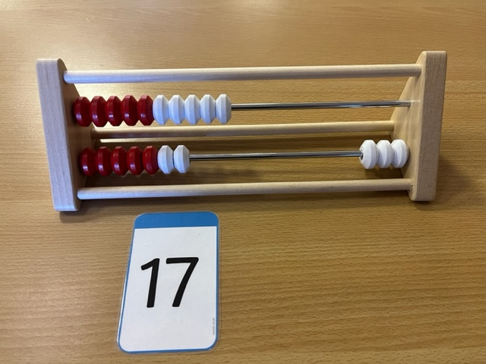
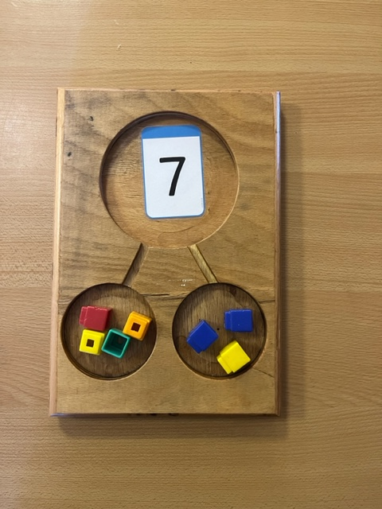
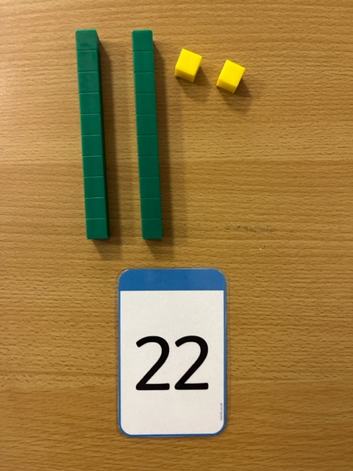
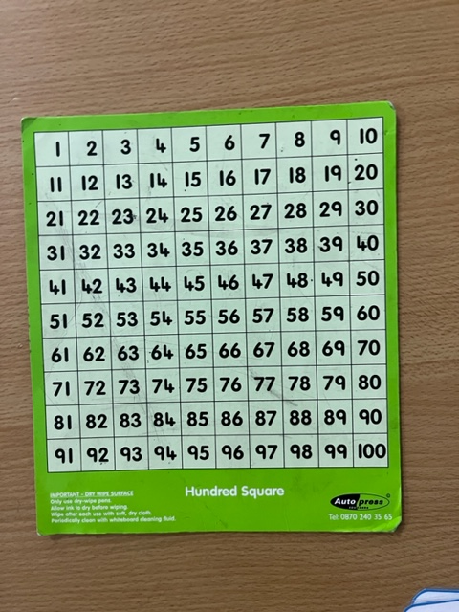
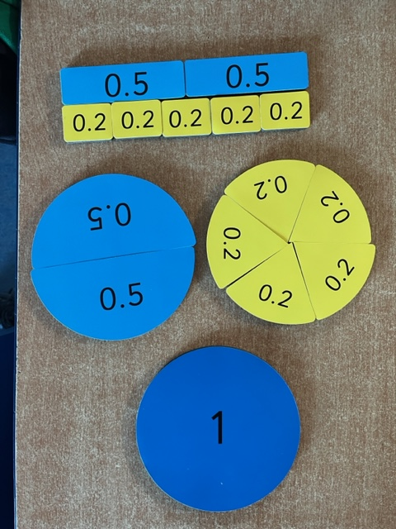
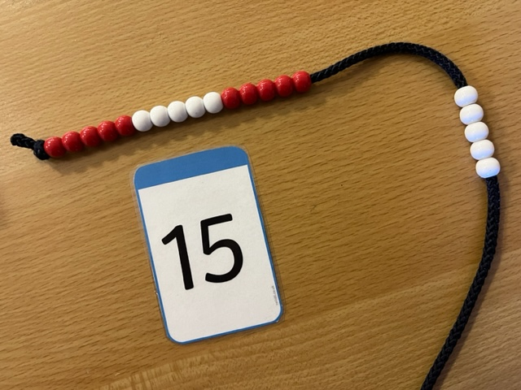

Slide 11
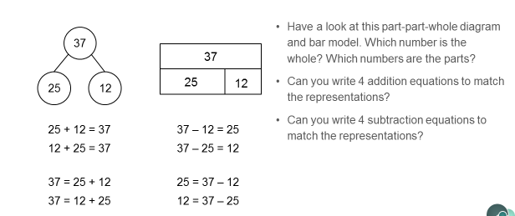
Models that support understanding

Slide 12
Bar models can help children to understand a word problem
Dan and Beth have 25 football
cards altogether.
Dan has collected 14.
How many has Beth collected?
25
14
?
25 = 14 + ___
14 + ___ = 25
25 – 14 = ___

Slide 13

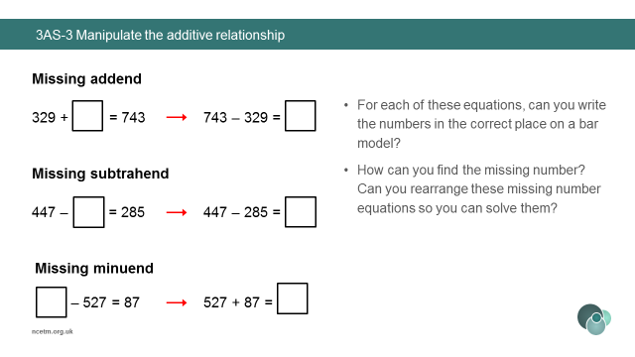
Bar models to help solve problems
743
329
447
285

Slide 14
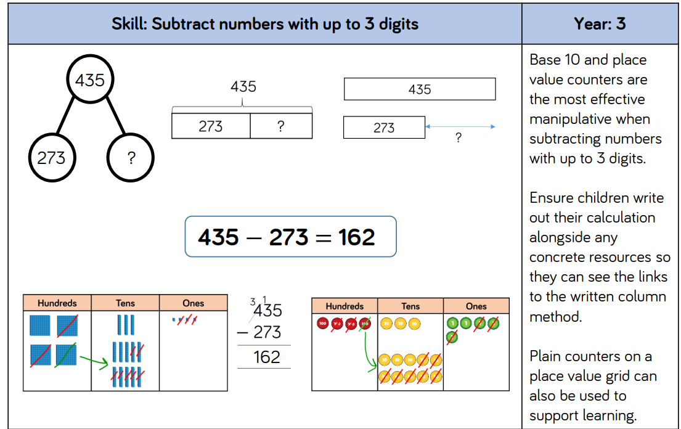

Slide 15
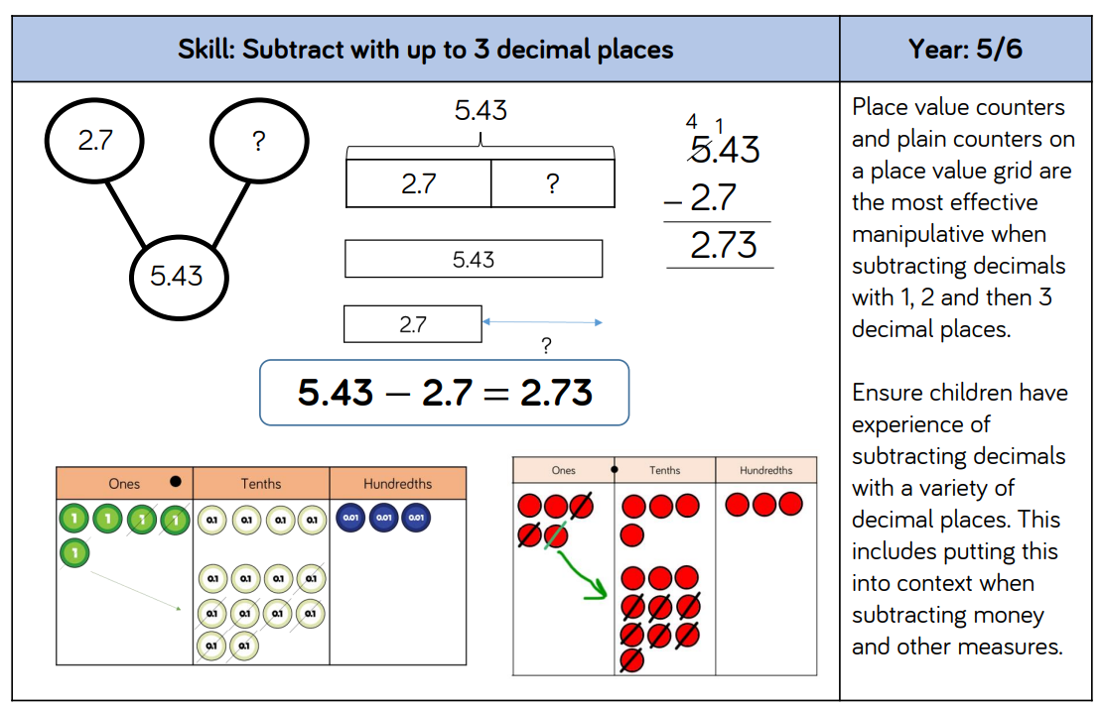

Slide 16
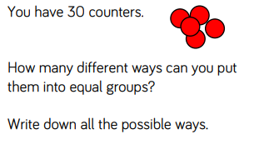
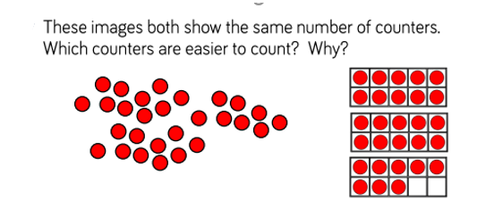
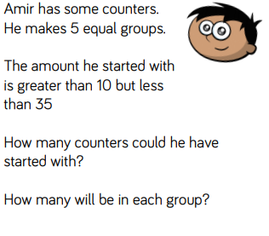
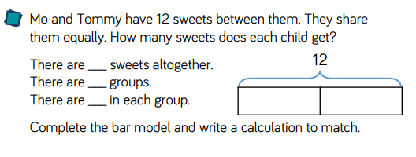
Problem Solving

Slide 17
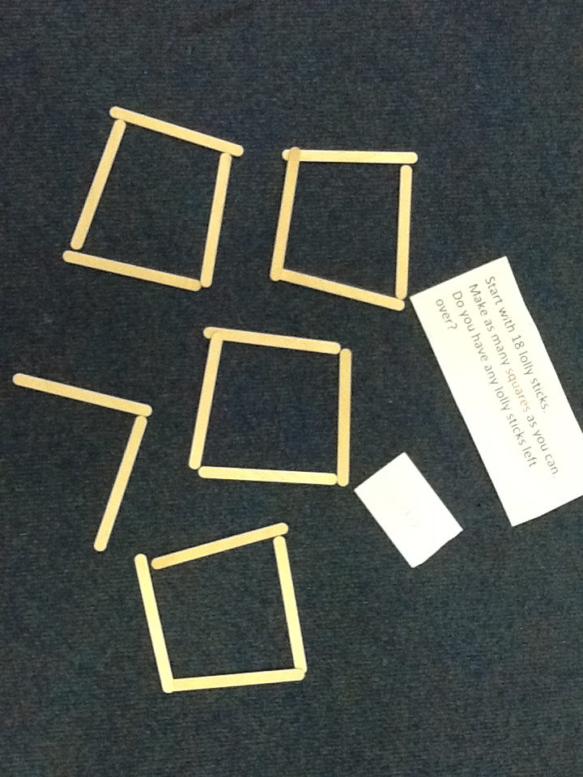
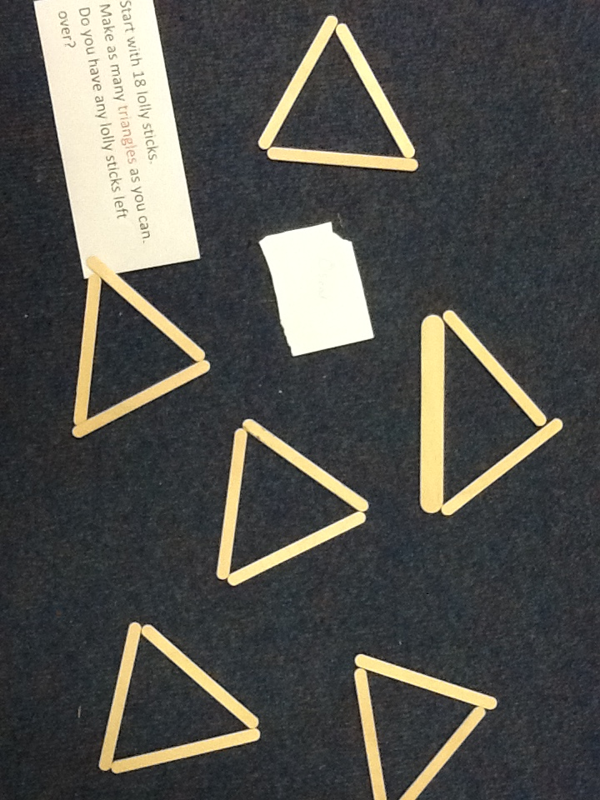
Solving problems

Slide 18
Vocabulary and stem sentences
Children are encouraged to used the correct maths terminology.
Maths vocabulary is built up as the children move through the school.
Children are introduced to stem sentences which they can use to support their understanding and to help them to remember what they are doing.
Example of a Year 1 sentence stem:
First, I had _____
Then I counted on ______
Now I have _________ .
To work out _____ + _____, I will count on from _____

Slide 19
High expectations for all
We expect children to:
Present their work well.
Show their calculations and working out.
Listen and to play an active role in their learning.
Explain their reasoning and demonstrate how they know an answer.
Practise skills learned outside of lessons – chanting times tables, using TTRockstars or other online resources.

Slide 20
Classrooms
Ask the children about their maths.
Do they like maths?
What are they learning or practising today?
Ask them to explain a method of working something out.

